Slide 1

FALL 2023
MIS 381N
Information management
Lecture 1
August 21st 2023
Prashant D. Joshi
UT McCombs School of Business (MSBA), The University of Texas at Austin

Slide 2

Objectives
Introductions
Syllabus review
Understand the importance of data and data management
Questions and discussion

Slide 3
What questions may I answer before we begin …
All questions are good questions

Slide 4

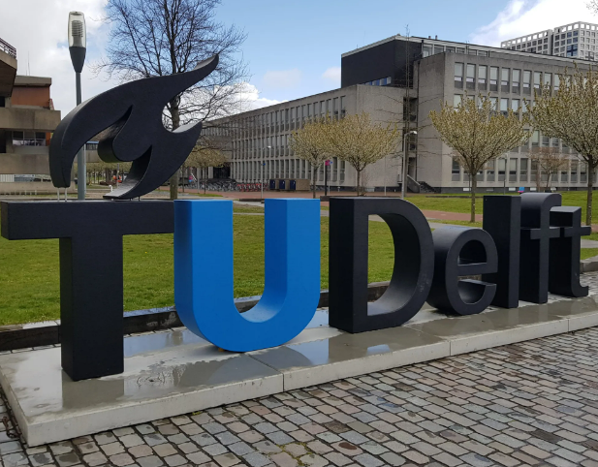








Introductions – Faculty

Slide 5
Getting in touch with me …
Email: prashant.joshi@mccombs.utexas.edu
prashant.joshi@gmail.com
Cell: 512 297 6381
Office Hours: TBD

Slide 6
Student Introductions

Slide 7
Undergraduate Major
Business Major | Engineering Major | Statistics/Math Major | Other | Other
10 | 35 | 5 | Bio1/Env/Comm 5
4 | 10 | 0 | Bio 1

Slide 8
Summer semester at UT?
Summer Semester | How did it fare? | How did it fare?
Awesome! | 10 | 5
Good! | 15 | 12
Glad its over! | 10 | 0
Head is still spinning! | 0

Slide 9
Pre-Course Survey Polling

Slide 10
Class Skill Level (N = 50)
 | Beginner | ... | Functional | ... | Experienced
Entity Relationship Modeling
SQL
Relational Database Management Systems
Data Governance & Stewardship (rules & implementation)
Master Data Management (business and IT Collaboration)
Data Warehouses & Data Marts (analytical warehouses, Marts are subsets for a single type of tasks)
NoSQL Databases (Non relational, non tabular)
Object Oriented Databases
Enterprise Data Architecture
Data Privacy and Security
Distributed Computing
Data Integration
Hadoop (Open-source framework for massive datasets)
Spark (Use of RAMs for speedup of small workloads)

Slide 11
Overall Class Skill Level
 | Skill/Class coverage expectation | Skill/Class coverage expectation
Entity Relationship Modeling
SQL
Relational Database Management Systems
Data Governance & Stewardship
Master Data Management
Data Warehouses & Data Marts
NoSQL Databases
Object Oriented Databases
Enterprise Data Architecture
Data Privacy and Security
Distributed Computing
Data Integration
Hadoop
Spark
N = 50

Slide 12
Class Focus expectations
Business technology hybrid
80%
Technology concepts
10%
Business concepts
10%

Slide 13
Selected Comments from past classes
If there are other subject areas that were not listed above that you would like this course to include, please describe them.
Could it briefly cover using cloud analytics services (AWS, AZURE, Google Cloud)? If they are not required for the capstone, then it's not necessary. I just think it may be helpful to have an understanding of them to prepare for our careers.
I've heard from experts that they think hadoop is dead and people are leaning towards spark.
Streaming Data Processing, Batch Data Processing, Data Lakes, Cloud Data Ecosystems, AWS/Azure/GCP vs. On Premise Data Ecosystems, Data Formats & Performance (Parquet, .csv, json, avro, etc. column store vs. row store vs. hybrid), Massive Parallel Processing (MPP), Query Engine Option, Deeply Nested Datasets
I don't have much experience in any of the topics.

Slide 14
Selected Comments from past classes
Please share any other information that you feel will be helpful for the course instructor.
I am aware that there some experienced data/ computer scientists in the class but a majority of us are completely new to the aforementioned technologies so I would appreciate it if you could go in depth.
Please teach us advanced SQL and NoSQL!!
I do not come from a business background; it would be super helpful if we could focus on how to create business value and strategic insights from our analysis.
I would prefer the course be a business technology hybrid but have more emphasis on highly technical aspects.
Business concepts could always be self-learned if the technical skill is mastered. I feel like the technical part always requires much more input and guidance compared to business sense.
Do not mind a heavy workload and wish to get technical about these skills while also being aware of how these skills get embedded in the company production cycle/how the are connected to other functions

Slide 15
Course Overview

Slide 16

Canvas
It will contain all details…
… however it will also be under construction!
Homework, quizzes, slide deck
Communication

Slide 17
Course Themes
Data management is a critical business & technology skill for business analysts
The rate of data captured in the world is growing exponentially – volume, velocity, variety, veracity, value
Data governance, ethics, security and privacy practices are critical
We need to harness relational and non-relational technology – SQL and NoSQL
Technology is necessary but not sufficient

Slide 18
Teaching Environment
Active learning (case discussions, breakout teams, hands-on work)
Your learning is in your hands, be good to yourself!
Be on time, respect everyone (all our situations are unique & different)
Self-directed learning is critical
Focus on learning and not grade

Slide 19
My Teaching philosophy/reasons
Teaching was not my career but my passion! After many years in the industry now I am following my dream!
University campus is bubbling with energy and enthusiasm! Awesome place to be!
The future of society… is sitting in this class! What better way to share with the future, even if one might not exist in it! (Time travel? ☺)
Teaching is a fascinating experience! Knowledge flows between brains! Energy cannot be created or lost… Knowledge can be!
Pass on the good fortune I have had during my experiences while sitting on the other side of the class!

Slide 20

My Teaching Philosophy
Get excited about learning, do not worry about grades!
4 decades later, you will not remember what grade you got in this class. But hopefully you will remember the concepts!

Slide 21
Is data important?
Some people say data is the new oil …
Others consider data to be exhaust …
Who is right?
What is the role of data management?
https://www.ted.com/talks/mr_srinidhi_shama_rao_is_data_the_new_oil

Slide 22
Is data important?
People
Strategy
Data, Analytics & Intelligence
Operations
Technology

Slide 23
Syllabus Overview
Objectives
Assessment (tentative)
Understand importance and value of data management
Data management components and context
Relational model – design & develop (ER models, RDBMS, SQL)
Data warehouses
Non-relational model – design & develop (NoSQL, MapReduce, Spark)
Data Governance, enterprise data architecture
Participation – 10%
HW assignments/quizzes – 30%
Midterm exam – 30%
Final group project – 30%

Slide 24

Next class
Read article about Data Strategy that will be posted on Canvas
Prepare to work in teams and discuss in class

Slide 25
What question may I answer before we end …?
Remember, all questions are good questions!

